Slide 1

12. BALANCED PARTICIPATION:
Team members contribute when appropriate, and member’s opinions are valued and sought. It is important when leaders define what type of participation they expect from members. Team members are valued for their unique skills and talents. A diversity of thinking, idea generating, problem solving, and experiences help to create an effective team.
Source: Covey’s Synergize
1. TRUST:
Many would say this is the most essential ingredient of a HPT. A foundational plank that teams need to build on.
Source: Blakey’s Trusted Executive
2. COMMON PURPOSE:
Team members understand the purpose and ‘why’ of the team/business. It is important to understand where the team is headed and the purpose for being together. Are the team aligned to this purpose (as a group and as individuals).
Source: Sinek’s ‘Why?’
3. MANAGED CONFLICT:
This is essential to a team’s growth. Benefits are a. the team will have to find ways to communicate differences/seek shared outcomes, b. the team will be forced to look at all points of view, c. improves creativity as they look beyond current assumptions, d. the quality of decisions will improve because through disagreement the team will look for solutions that meet everyone’s objectives.
Source: Lencioni’s 5 Dysfunctions of Team
11. CONSENSUS FOCUSED:
Team members want to work together for the good of the team and understand that combining the skills of numerous people will produce something that could not be created alone. The strength of each team member is being utilised. Feedback is given/received constructively.
Source: HBR’s analysis of collaboration & Covey’s ‘Win Win’.
10. DEFINED ROLES:
It’s important for group members to understand their job function and for leaders to tap into the skills and talents of group members. Interdependence and cooperation are key here.
Source: Triaxia’s HPT model
MIND-GAP’S 12 CHARACTERISTICS OF HIGH PERFORMING TEAMS
4. ACCEPTED LEADERSHIP:
Followers need to rate and respect the Leadership of the business. Is there ‘discretionary effort’ (going the extra mile) by teams and individuals?
Source: Maxwell’s 5 levels of Leadership
9. EXCELLENT COMMUNICATION:
Open and clear communication will keep a team informed and focused. Communication “breakdowns” can often be attributed to poor listening skills. It’s important to focus on hearing the message before forming our own conclusions about the message.
Source: Covey’s Seek first to understand
5. PROACTIVE NOT REACTIVE:
The team spends a good % of it’s time “in the crow’s nest” looking at direction rather than getting caught up in the daily detail. Source: Covey’s ‘Be Proactive’ & ‘Start with the end in mind’
Developed from research undertaken by www.mind-gap.co.uk
Self assess you team against these areas
on page 2
8. CLEAR GOALS:
Team members who were involved in establishing the goals will work to achieve them. They understand the translation of strategy to their personal plans.
Source: Wickman’s 90-day rocks
7. POSITIVE ATMOSPHERE:
Effective teams have an open climate where members are comfortable with each other and are unafraid to take risks. Trust is a key element is creating this atmosphere. Honesty, accessibility, acceptance,and dependability are key.
Source: Building a positive team climate
6. LEARNING & REFLECTION:
The team learns from its successes and failures. There is a culture that learns from all that the team does, and it is an embedded approach at both personal and team levels.
Source: Ribeiro’s reflective team working and Covey’s ‘Sharpen the saw’
Copyright: @ mind-gap
Unlocking Leadership Potential In Individuals, Teams, Businesses and Communities

Slide 2
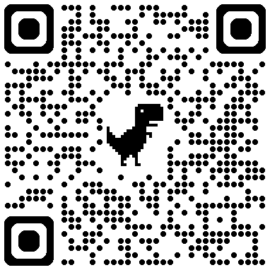
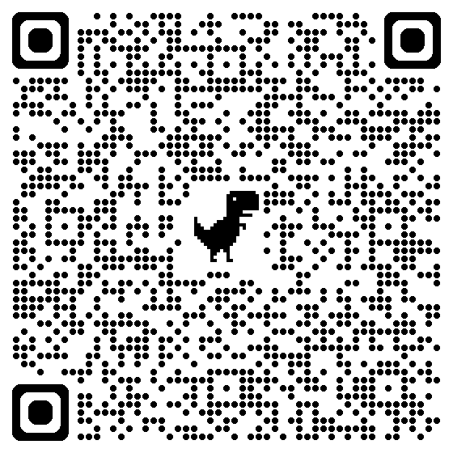
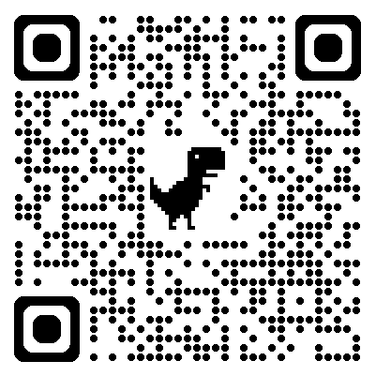
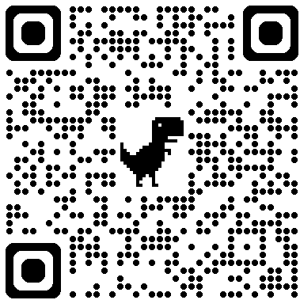
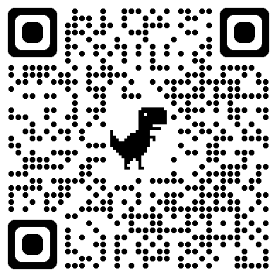
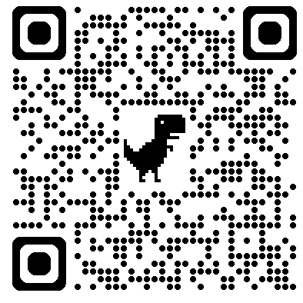
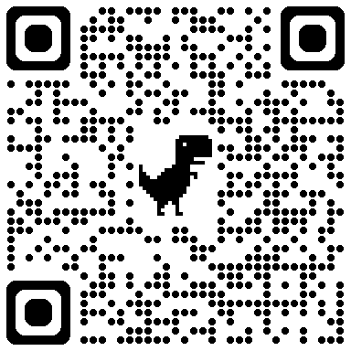
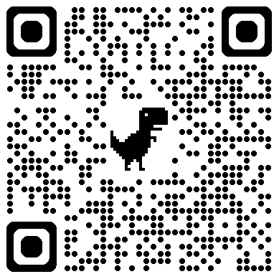
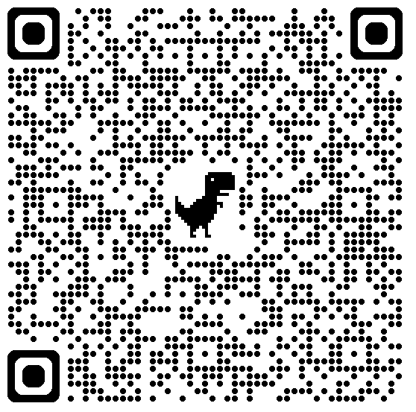
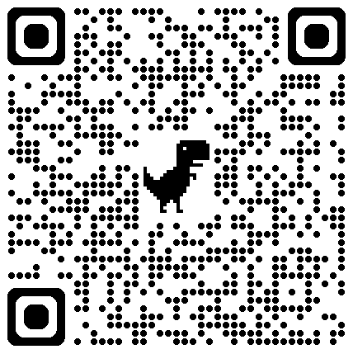
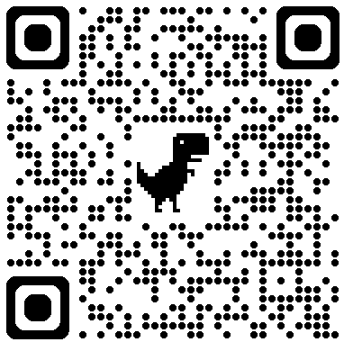
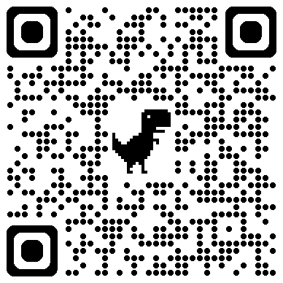
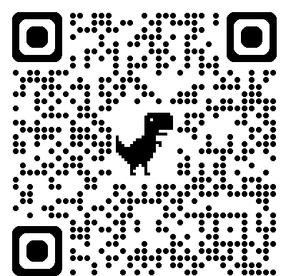
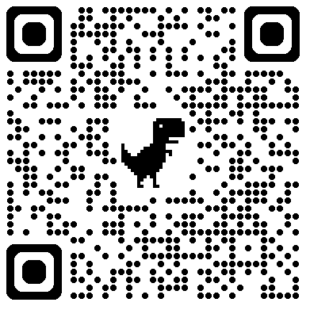
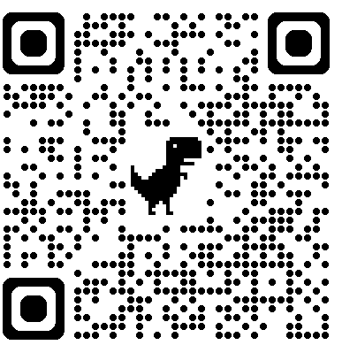
HIGH PERFORMING TEAM CRITERIA Note hyperlinks for sources | QR link | How do you rank this in your organisation? | Your scores on your team |  | COMMENTS / ACTIONS: What can you practically do to get them to an HPT?
 |  |  | SCORE NOW 1 (low) to10 (high) | NEXT YEAR 1 (low) to10 (high)
TRUST: Many would say this is the most essential ingredient of a HPT. A foundational plank that teams need to build on. Source: Blakey’s Trusted Executive
COMMON PURPOSE: Team members understand the purpose and ‘why’ of the team/business. It is important to understand where the team is headed and the purpose for being together. Are the team aligned to this purpose (as a group and as individuals). Source: Sinek’s ‘Why?’
MANAGED CONFLICT: This is essential to a team’s growth. Benefits are: a. the team will have to find ways to communicate differences/seek shared outcomes, b. the team will be forced to look at all points of view, c. improves creativity as they look beyond current assumptions, d. the quality of decisions will improve because through disagreement the team will look for solutions that meet everyone’s objectives. Source: Lencioni’s 5 Dysfunctions of Team
ACCEPTED LEADERSHIP: Followers need to rate and respect the Leadership of the business. Is there ‘discretionary effort’ (going the extra mile) by teams and individuals? Source: Maxwell’s 5 levels of Leadership
PROACTIVE NOT REACTIVE: The team spends a good % of it’s time ‘in the crow’s nest looking at direction rather than getting caught up in the daily detail. Source: Covey’s ‘Be Proactive’ & ‘Start with the end in mind’
LEARNING & REFLECTION: The team learns from its successes and failures. There is a culture that learns from all that the team does and it is an embedded approach at both personal and team levels. Source: Ribeiro’s reflective team working and Covey’s ‘Sharpen the saw’
POSITIVE ATMOSPHERE: An effective team has an open climate where members are comfortable with each other and aren’t afraid to take risks. Trust is a key element is creating this atmosphere. Honesty, accessibility, acceptance, and dependability are key. Source: Ulloa’s Attitude and effective teamworking
CLEAR GOALS: Team members who were involved in establishing the goals will work to achieve them. They understand the translation of strategy to their personal plans Source: Wickman’s 90 day rocks
EXCELLENT COMMUNICATION: Open and clear communication will keep a team informed and focused. Communication “breakdowns” can often be attributed to poor listening skills. It’s important to focus on hearing the message before forming our own conclusions about the message. Source: Covey’s Seek first to understand
DEFINED ROLES: It’s important for group members to understand their job function and for leaders to tap into the skills and talents of group members. Interdependence and cooperation are key here. Source: Triaxia’s HPT model
CONSENSUS FOCUSED: Consensus is considered one of the best methods to use, however team members should select a method that works best for them by weighing each method’s advantages and disadvantages. Team members want to work together for the good of the team and understand that combining the skills of numerous people will produce something that could not be created alone. The strength of each team member is being utilised. Feedback is given/received constructively. Source: HBR’s analysis of collaboration & Covey’s ‘Win Win’.
BALANCED PARTICIPATION: Team members contribute when appropriate, and member’s opinions are valued and sought. It is important when leaders define what type of participation they expect from members. Team members are valued for their unique skills and talents. A diversity of thinking, idea generating, problem solving and experiences help to create an effective team. Source: Covey’s Synergize

