Slide 1

12. BRAVE
Some aspects of Leadership might come to you naturally, but others are universally uncomfortable and challenging—and one of those is courage!
Courage isn't a natural response to difficult situations and decisions. It's a learned and practiced one. Courageous leadership, in those moments, involves fighting through your natural responses which would ultimately hold you back.
Source: Korn Ferry
1. AUTHENTIC & VALUES DRIVEN
Many would say that authenticity is the most essential ingredient of Leader. Without it one has no anchor in decision making, relationships and business generally.
Source: Harvard Business School
2. OUTWARD FOCUSED
Our interconnected world is so volatile that the need to be future focused has become more important than ever. Not just to navigate potential obstacles but to seek out market opportunities too.
Source: Roffey Park Institute
3. ‘SENSE-MAKER’
Good Leadership stimulates new ways of seeing, understanding, thinking, problem-solving, acting and working together.
Leaders promote new ways to understand the deeper purpose behind work. Their efforts help their people see clarity through the fog!
Source: Forbes
11. CUSTOMER AND SERVICE FOCUSED:
Many of the other areas of this assessment are focused on the characteristics of a Leader, but a Leader has to be obsessed with what the customer needs or there is no business. This is the strength of the "Amazon's of this world. A solid understanding of what the customer needs and how to service that need is essential.
Source: Smartkarrot
4. ENABLER AND COACH
We have learnt that the ‘command & control’ (push) approach has a limited shelf life! The ‘pull’ approach of the Coach seeks to draw out the opinions/solutions of all the team, empowering them and their ownership and creating breadth of ways forward
Source: Harvard Business School
10. POSITIVE COMMUNICATOR:
All other areas in this tool are only useful if they can be communicated to people in a way that inspires. Story telling, sense making, inspiration and vision setting are all critical Leadership skills if we are to inspire our people
Source: Harvard Business Review
MIND-GAP’S TOP
12 LEADERSHIP CHARACTERISTICS
9. ACCOUNTABLE, HUMBLE AND VULNERABLE
For generations, ego and status have driven Leadership. But haven’t we seen what that does to business and our countries? People are seeking humility in Leaders. Not weak humility or vulnerability but a brave ownership of mistakes and faults and a human workers can resonate with.
Source: Edgar Schein
5. EMOTIONALLY INTELLIGENT AND RESILIENT
EI is possibly one of the most talked about concepts in Leadership these days. Leaders who have the ability to manage ‘self’ and ‘others’ and stay resilient in themselves in challenging times is a key Leadership trait. Source: Daniel Goleman and Forbes
Developed from research undertaken by www.mind-gap.co.uk
Assess yourself against these
criteria overleaf
8. AGILE AND ADAPTIVE
In our fast-paced, volatile world, the need to be agile and adaptive to external and internal pressure is critical. Leaders are needing to move from an ‘expert’ role to that of ‘catalyst'.
Source: Forbes & Agile Business
7.SKILLS CHEF!
In a global/VUCA world, Leaders need to have the skills to be able to take a range of organisational skills (typically not traditional ‘ingredients’) and create something new. This ‘mix' may include using high levels of Emotional Intelligence, alongside elements of automation and AI, for instance.
Source: Jacob Morgan. Future Organisation
6. COLLABORATION AND RELATIONSHIPS DRIVEN
Leadership is not a position, it is an action (Sinek) and therefore you need to be the kind of Leader people want to follow!
Whilst the Leader needs to be collaborative in approach there is a need to understand and celebrate differences too.
Source: Matthew Syed, Rebel Ideas
Copyright: @ mind-gap
Unlocking Leadership Potential In Individuals, Teams, Businesses and Communities

Slide 2
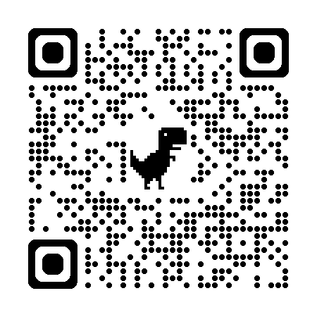
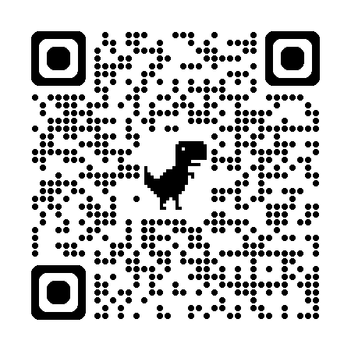
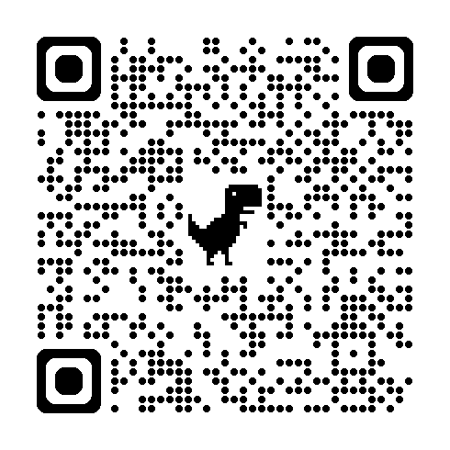
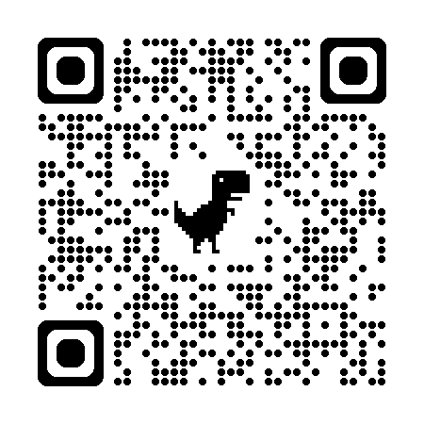
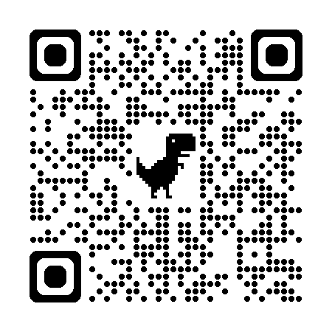
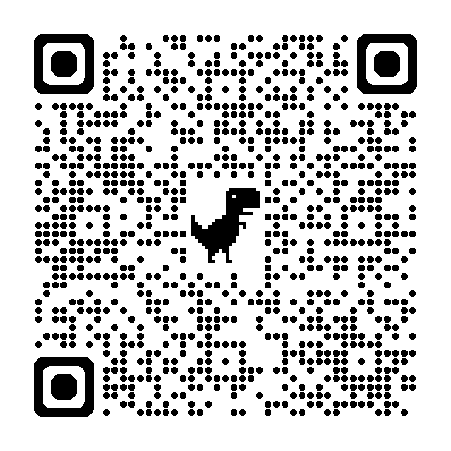
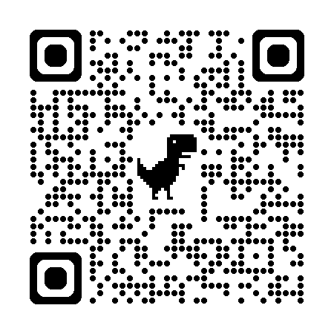
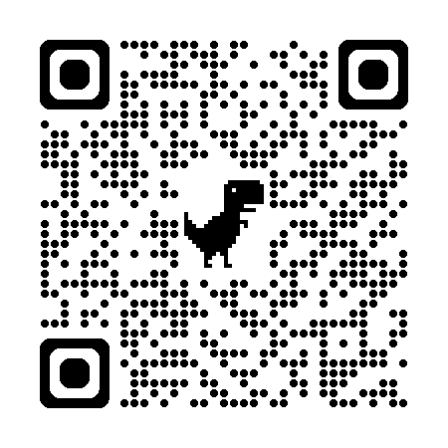
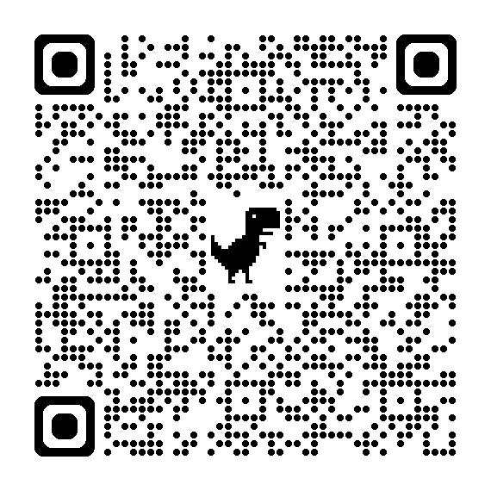
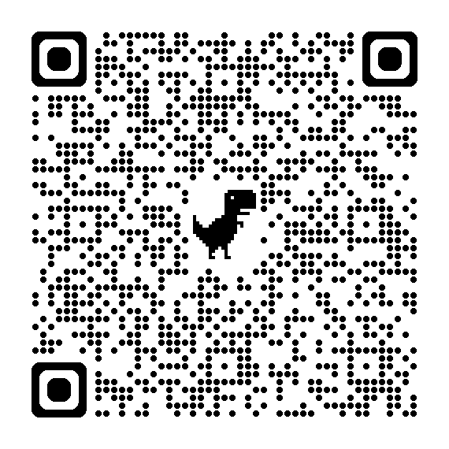
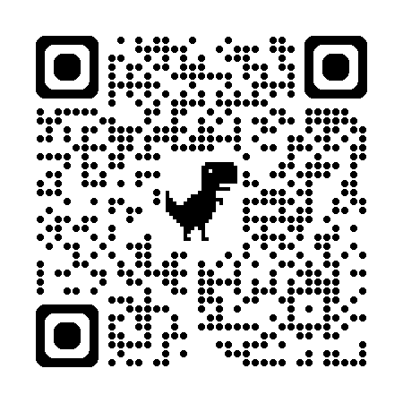
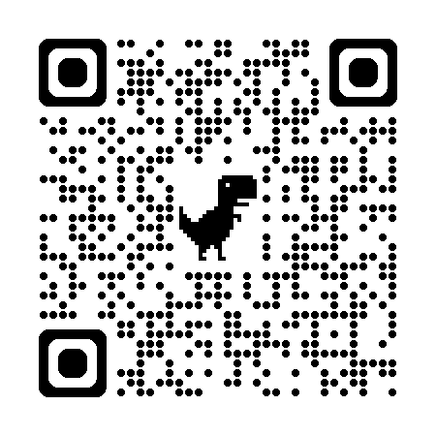
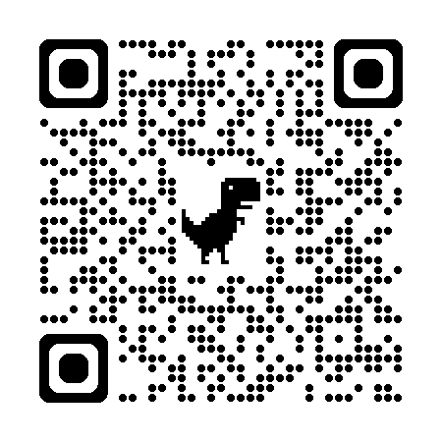
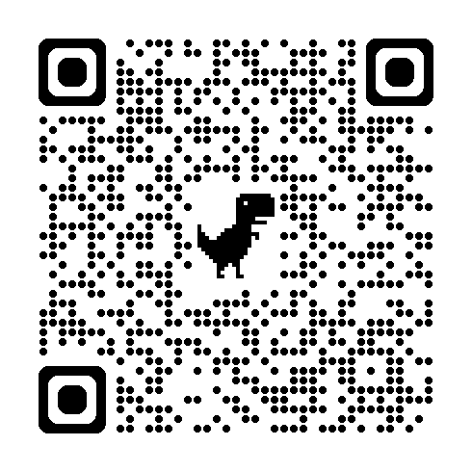
LEADERSHIP COMPETENCY CRITERIA Note hyperlinks for sources | QR LINK FOR ADDITIONAL RESOURCES | RANK YOURSELF IN THIS AREA /10 | COMMENTS / ACTIONS: WHAT CAN YOU PRACTICALLY DO TO DEVELOP IN THESE AREAS?
AUTHENTIC & VALUES DRIVEN: Many would say that authenticity is the most essential ingredient of Leader. Without it one has no anchor in decision making, relationships and business generally. Source: Harvard Business School
2. OUTWARD FOCUSED: Our interconnected world is so volatile that the need to be future focused has become more important than ever. Not just to navigate potential obstacles but to seek out market opportunities too. Source: Roffey Park Institute
3. ‘SENSE-MAKER’: Good Leadership stimulates new ways of seeing, understanding, thinking, problem-solving, acting and working together. Leaders promote new ways to understand the deeper purpose behind work. Their efforts help their people see clarity through the fog! Source: Forbes
4. ENABLER AND COACH: We have learnt that the ‘command & control’ (push) approach has a limited shelf life! The ‘pull’ approach of the Coach seeks to draw out the opinions/solutions of all the team, empowering them and their ownership and creating breadth of ways forward. Source: Harvard Business School
5. EMOTIONALLY INTELLIGENT AND RESILIENT: EI is possibly one of the most talked about concepts in Leadership these days. Leaders who have the ability to manage ‘self’ and ‘others’ and stay resilient in themselves in challenging times is a key Leadership trait. Source: Daniel Goleman and Forbes
6. COLLABORATION AND RELATIONSHIPS DRIVEN: Leadership is not position, it is an action (Sinek) and therefore you need to be the kind of Leader people want to follow! Whilst the Leader needs to be collaborative in approach there is a need to understand and celebrate difference too. Source: Matthew Syed, Rebel Ideas
7.SKILLS CHEF!: In a global/VUCA world, Leaders need to have the skills to be able to take a range of organisational skills (typically not traditional ‘ingredients’) and create something new. This ‘mix' may include using high levels of Emotional Intelligence, alongside elements of automation and AI, for instance. Source: Jacob Morgan. Future Organisation
8. AGILE AND ADAPTIVE: In our fast-paced, volatile world, the need to be agile and adaptive to external and internal pressure is critical. Leaders are needing to move from an ‘expert’ role to that of ‘catalyst'. Source: Forbes & Agile Business
9. ACCOUNTABLE, HUMBLE AND VULNERABLE: For generations, ego and status has driven Leadership. But haven’t we seen what that does to business and our countries? People are seeking humility in Leaders. Not weak humility or vulnerability but a brave ownership of mistakes and faults and a human workers can resonate with. Source: Edgar Schein
10. A POSITIVE COMMUNICATOR: All other areas in this tool are only useful if they can be communicated to people in a way that inspires. Story-telling, sense making, inspiration and vision setting are all critical Leadership skills if we are to inspire our people. Source: Harvard Business Review
11.CUSTOMER AND SERVICE FOCUSED: Many of the other areas of this assessment are focused on the characteristics of a Leader but a Leader has to be obsessed with what the customer needs - or there is no business. This is the strength of the Amazon’s of this world. A solid understanding of what the customer needs and how to service that need is essential. Source: Smartkarrot
12. BRAVE: Some aspects of Leadership might come naturally but others are often uncomfortable and challenging. One of those is courage! It isn't a natural response to difficult situations and decisions. It's a learned and practiced one. Courageous leadership involves fighting through your natural responses in those moments, which will ultimately hold you back. Source: Korn Ferry
Copyright: @ mind-gap
Unlocking Leadership Potential In Individuals, Teams, Businesses and Communities

